Slide 1
Angular & React Accessibility (A11Y) Basics
Vanilla HTML
Single Page Applications (Using Angular, React, etc.)
Gold Standard of Accessibility Friendly Development
Least need to make special accommodations specifically for Accessibility
Changes many of the basic tenants of how the web works
By default often operate in a way contrary to how Assistive Technology works to aid users
Often override other settings that enable Accessibility
May have Accessibility Capabilities but often those capabilities are not enabled by default.

Slide 2
What do we need to understand about SPA Frameworks like Angular & React?
Frameworks Generally Abstract Away the HTML Layer: Meaningful HTML is Vital to A11Y
SPA interactions can alter the ability to Keyboard Navigate: Keyboard Navigation is Fundamental to Accessibility
Frameworks often override Visible Focus: Visible focus is vital for keyboard users
SPA interactions override the basic “Click Link / Get New Page” model of the web: Most Assistive Technology is reliant on this model by default
A Framework that “Supports Accessibility” doesn’t guarantee Accessible End-Products: TEST TEST TEST!

Slide 3
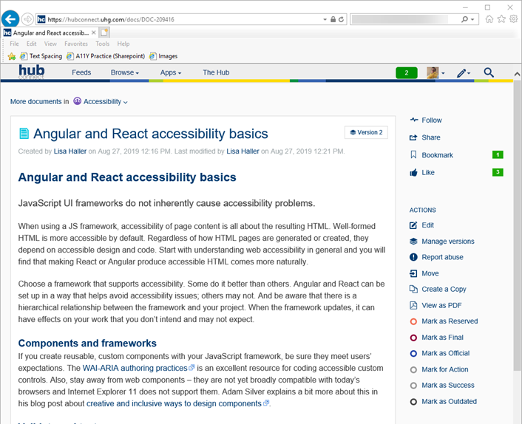
Accessibility on Hub Connect: Angular and React accessibility basics
URL: https://hubconnect.uhg.com/docs/DOC-209416

